Slide 1
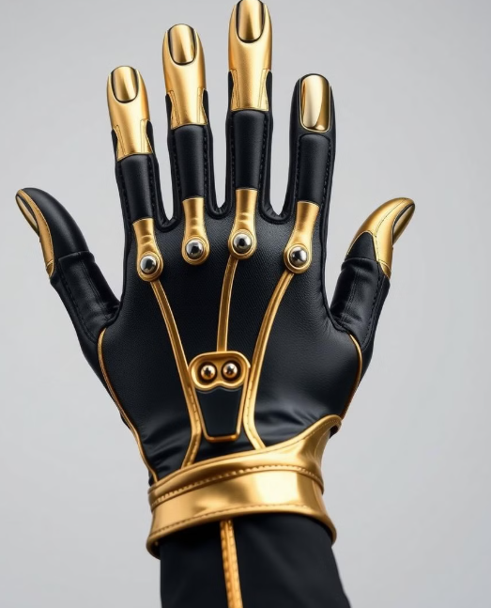
Sign language to text conversion
Name of the students:
PRUTHVIRAJ S YALI
VARSHA T R
VISHWAS M
SUMANTH N G

Slide 2
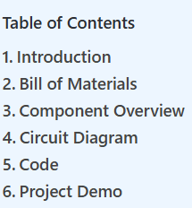

Slide 3
Introduction
In this article, I explain how we made an Arduino-based Sign Language to Text Conversion project to help Deaf people. Sign language is a natural way of communication between normal and dumb people. Sign language is mostly dependent on hand gesture recognition.
It is sometimes not easy for normal people to recognize the signs properly and understand what they want to say. The intention of the gloves is to make the lifestyle of the dumb and deaf people easy.
Each flex sensor is supplied with the initial voltage as per the movement of the fingers there will be a voltage drop because of the change in the resistance due to the bending of the flex sensor on the fingers.
That voltage we set the threshold value in the code when you band the Flex sensor and cross the threshold value the set text will display in the 16×2 L
lcd display and Bluetooth App.

Slide 4
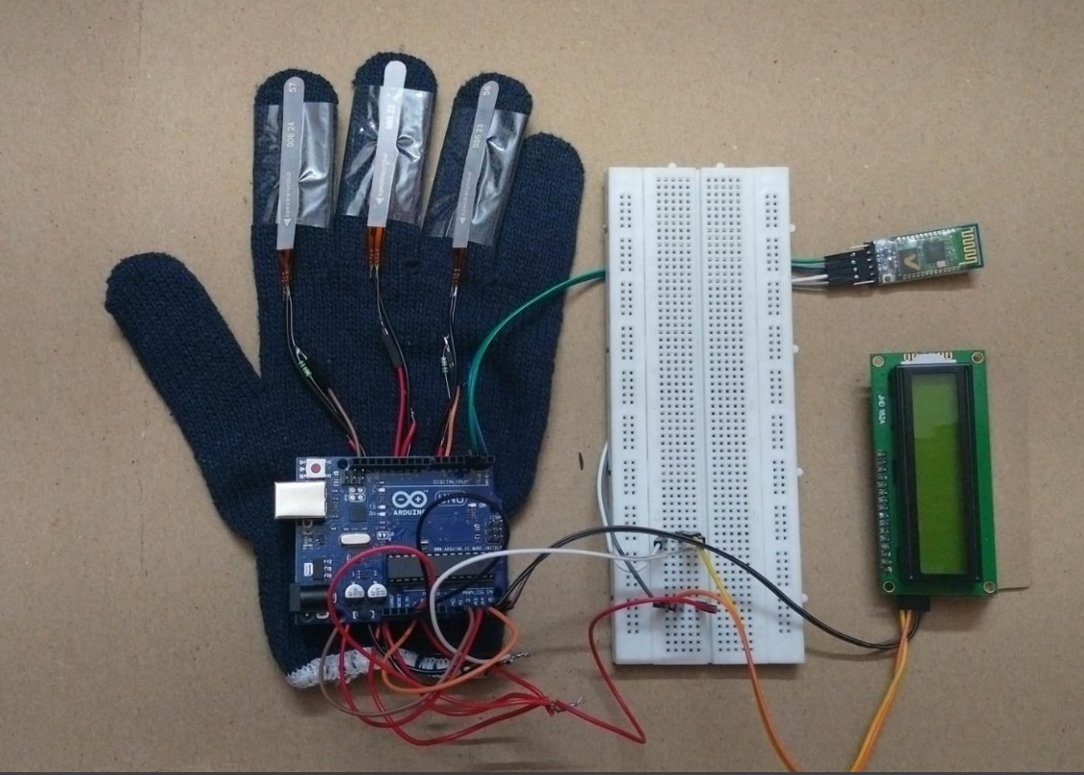
Photo copy

Slide 5
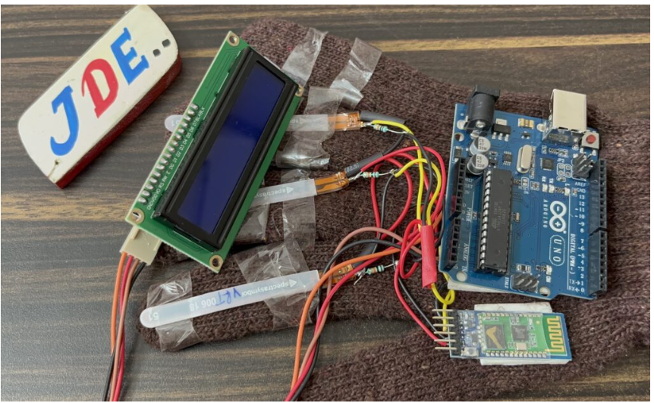
Bill of Materials

Slide 6
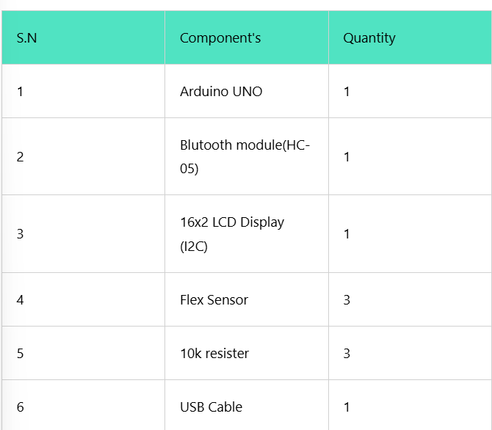
Components used

Slide 7
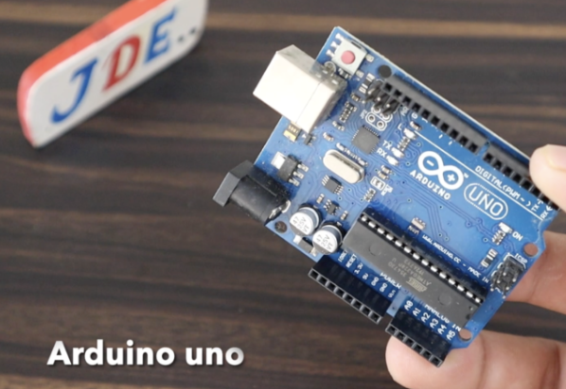
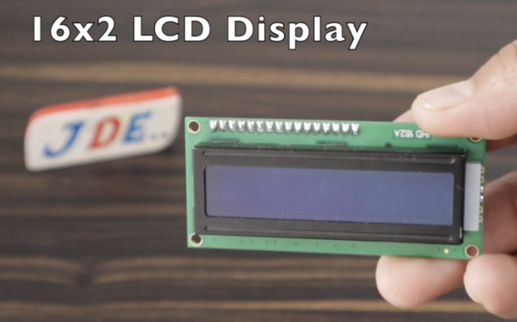
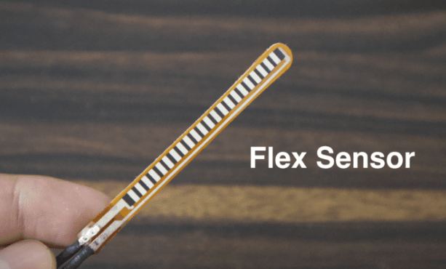
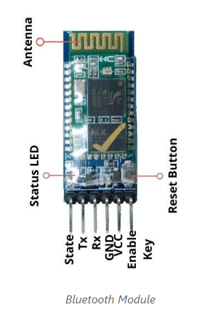
Components Overview

Slide 8
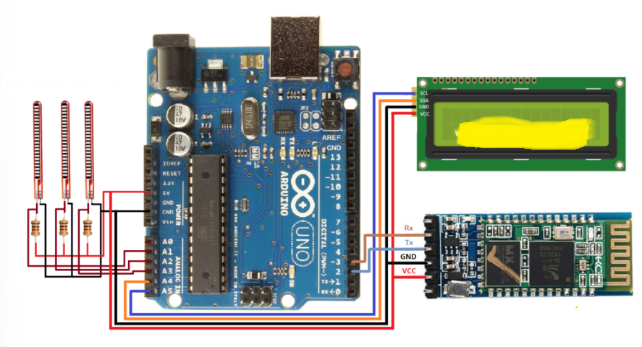
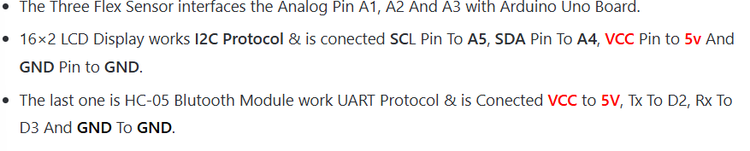
Circuit Diagram

Slide 9
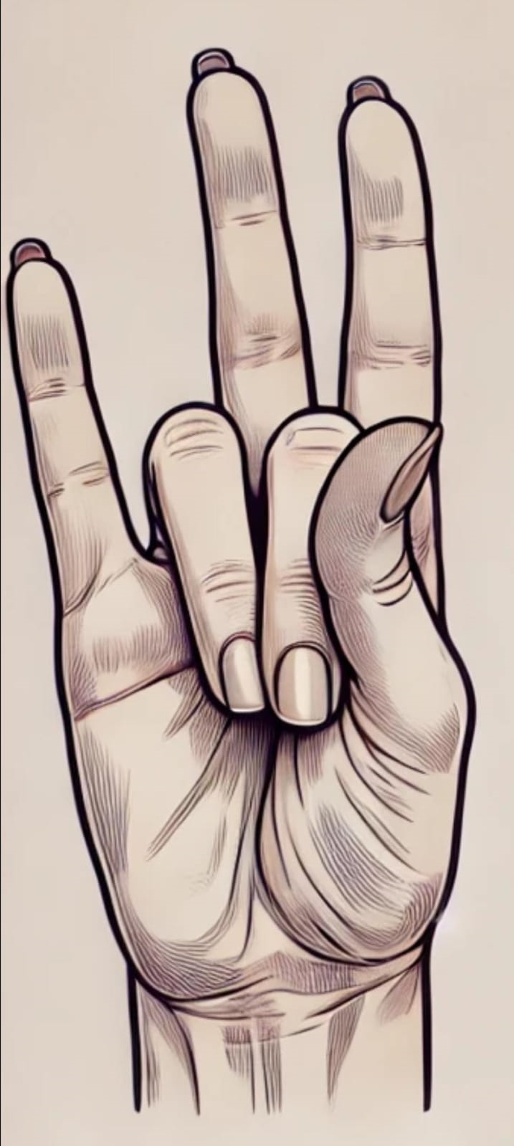
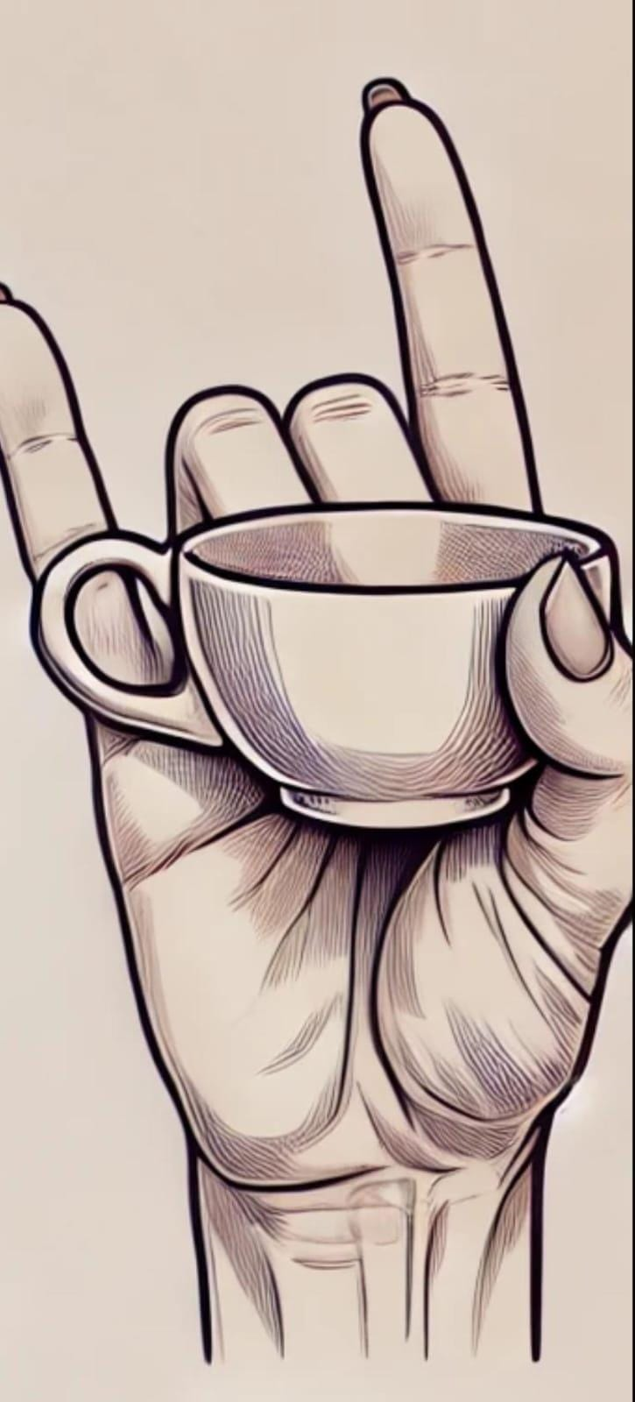
Few Examples of Deaf and Dumb Gesturis
WATER TEA

Slide 10
The Diversity of sign Language Unique Gestures Across Cultures
There is no universal sign language for deaf and mute people, as different regions and cultures have developed their own sign languages, such as American Sign Language (ASL), British Sign Language (BSL), and Indian Sign Language (ISL). These languages have distinct gestures and meanings, making communication unique to each region. Since no single standard exists, new gestures can be created as long as they are intuitive and easily understood.These specific gestures are chosen to ensure clarity and distinction between different meanings, reducing confusion in communication. Bending the index and ring fingers for 'water' mimics the natural action of holding a glass, while bending the middle and ring fingers for 'tea' represents the delicate grip used when holding a teacup.

Slide 11
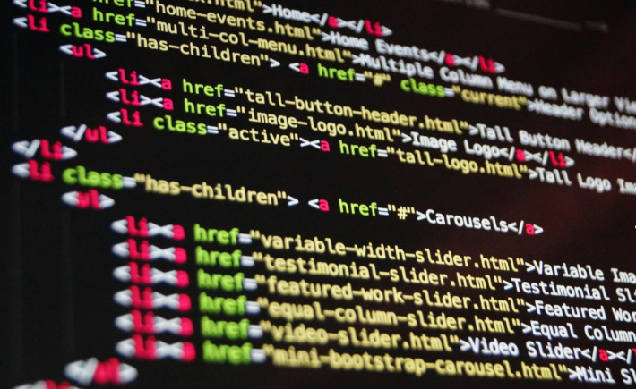
Code

Slide 12
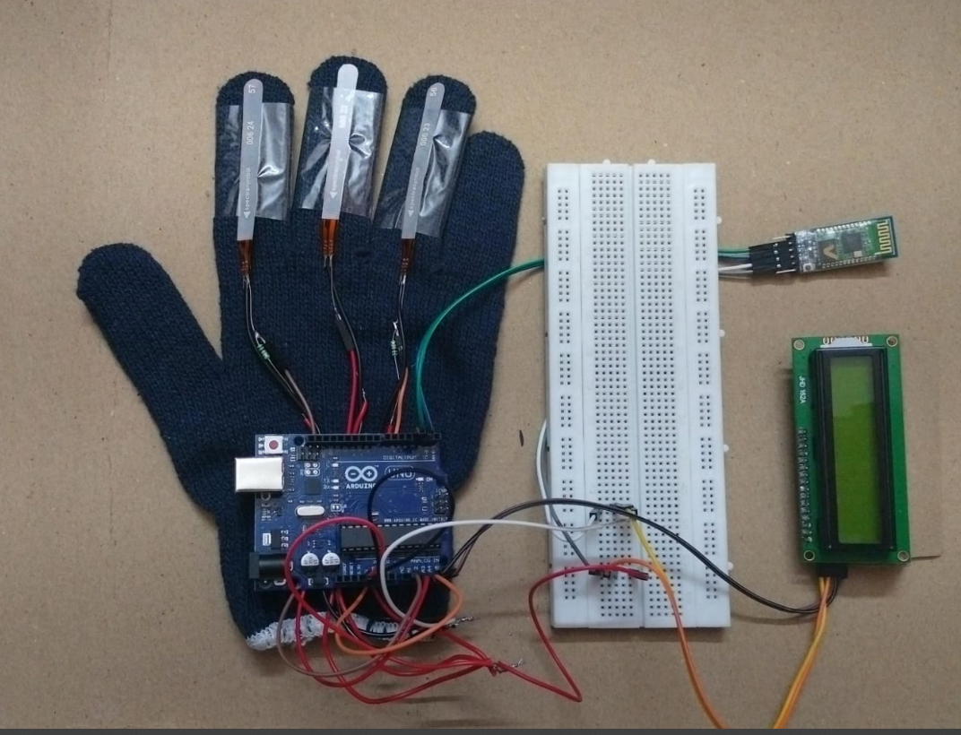
Project Demo

Slide 13

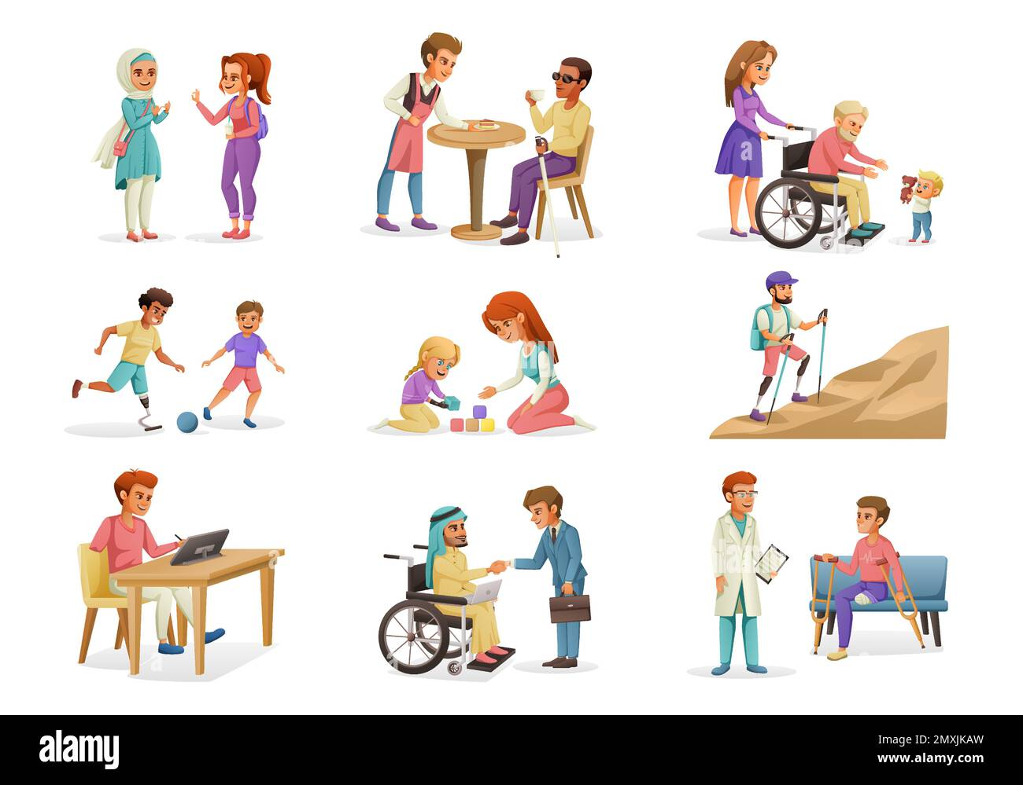
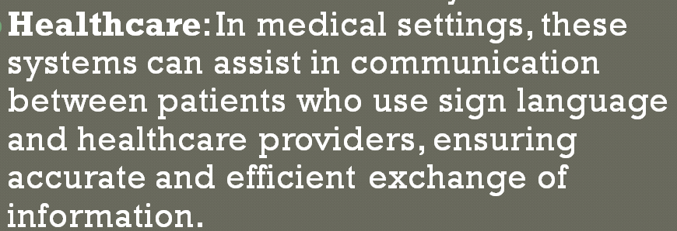
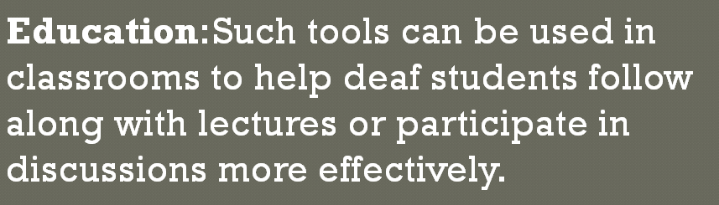
Application of the Project
Education :
HEALTHCARE

Slide 14
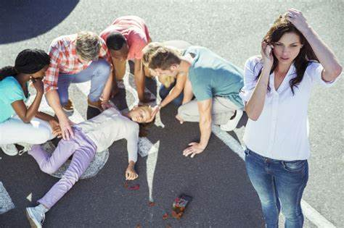
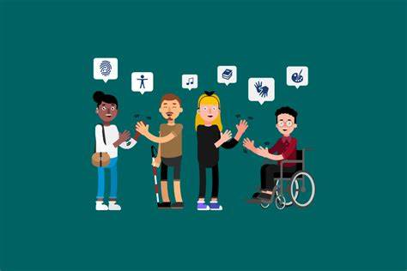
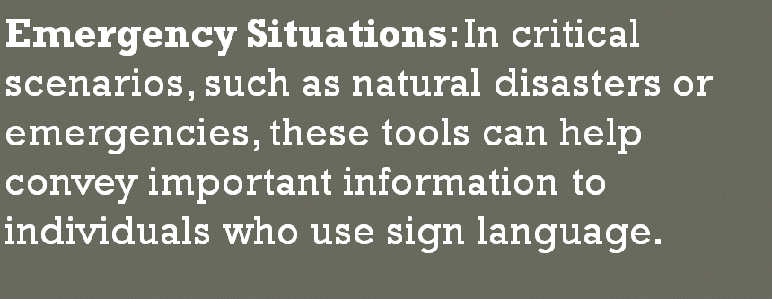
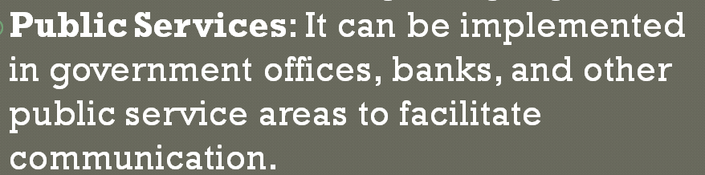
Applications of the project
EMERGENCY SITUATION
PUBLIC SERVICES

Slide 15



